Slide 1
Disclaimer
These slides are intended as presentation aids for the lecture. They contain information that would otherwise be to difficult or time-consuming to reproduce on the board. But they are incomplete, not self-explanatory, and are not always used in the order they appear in this presentation. As a result, these slides should not be used as a script for this course. I recommend you take notes during class, maybe on the slides themselves. It has been shown that taking notes improves learning success.

Slide 2
Reading for this set of slides
Craig – Intro to Robotics (3rd Edition)
Chapters 2 and 3
Please note that this set of slides is intended as support for the lecture, not as a
stand-alone script. If you want to study for this course, please use these slides
in conjunction with the indicated chapters in the text books. The textbooks are
available online or in the TUB library (many copies that can be checked out for the entire semester. There are also some aspects of the lectures that will not be
covered in the text books but can still be part of the homework or exam. For those
It is important that you attend class or ask somebody about what was covered in class.

Slide 3
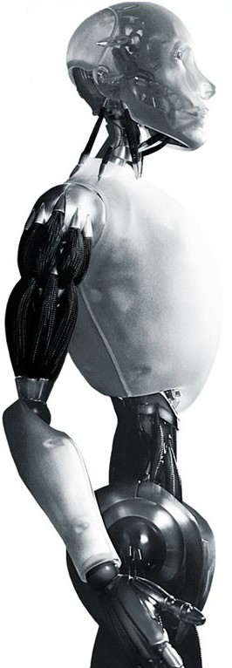
Robotics Track a Shape with the End-Effector
TU Berlin
Oliver Brock

Slide 4
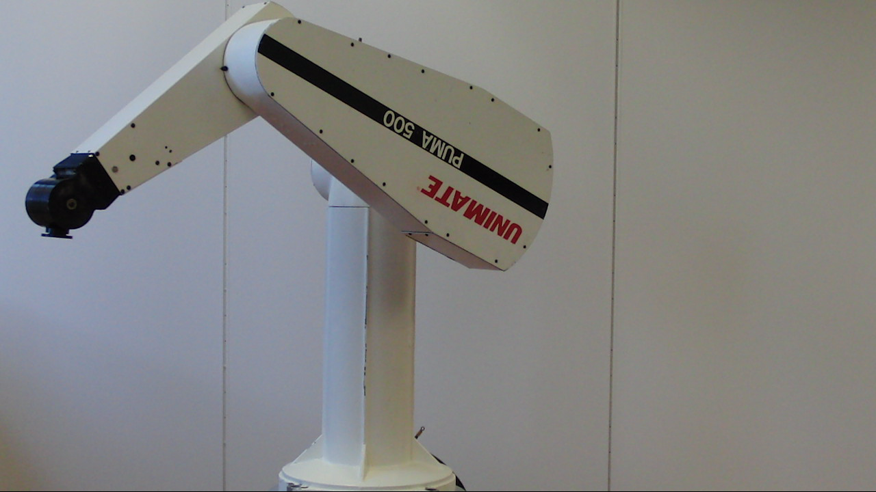

Slide 5
What do we need now?
A way to specify a trajectory (task) for the end-effector
A control law to move the end-effector along the specified trajectory
But first: a way to determine the joint angles, given a desired pose of the end-effector – or: a way to determine how to move the joints so that the error is reduced!
To improve performance of the controller: dynamic compensation (feed-forward model of the robot’s dynamics)
Notes:
1) task description, specify single position, specify time-parameterized path (trajectory) of the end-effector
2) error is now expressed in terms of end-effector pose!
3) inverse kinematics will not be covered in this class (maybe later, but: see the text book for an overview, the material is included in the exam), only numerical methods based on the Jacobian
4) what did you learn from tuning the gains in the homework? we will consider mass, but not yet centrifugal and Coriolis forces

Slide 6
Robotics Where is the End-Effector? Forward Kinematics: Homogeneous Transforms, Spatial Representations
TU Berlin
Oliver Brock

Slide 7


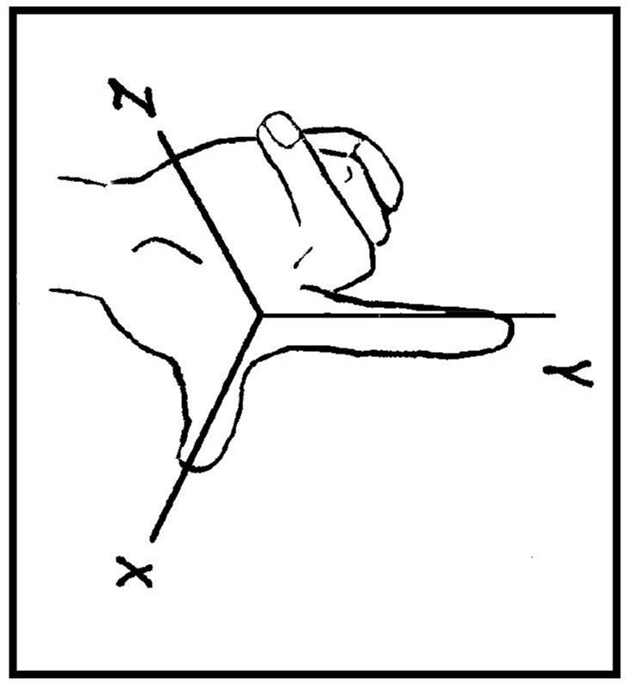


Object Position and Orientation
z
y
x
right-handed coordinate system

Slide 8
Kinematics
Webster
Kinematics: branch of dynamics that deals with aspects of motion apart from considerations of mass and force
Dynamics: branch of mechanics that deals with forces and their relation primarily to the motion but sometimes also to the equilibrium of bodies
Mechanics: branch of physical science that deals with energy and forces and their effect on bodies
Here: relationship between joint motion and motion of rigid bodies (links) without regard for the forces that cause it

Slide 9
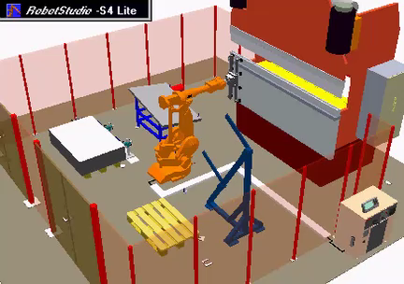
Where is the end-effector?
Robert Bohlin

Slide 10
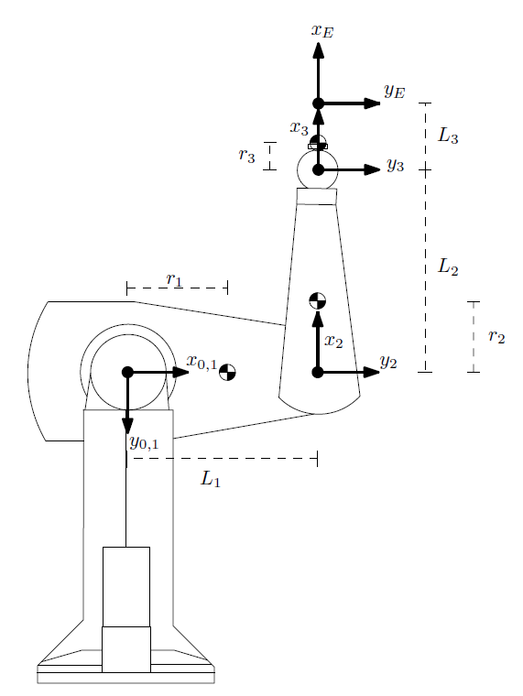
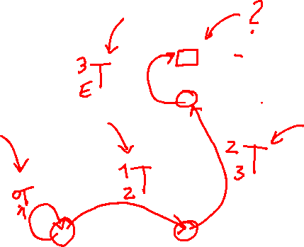
Notes:
All z-axes point into the plane
DH parameters

Slide 11
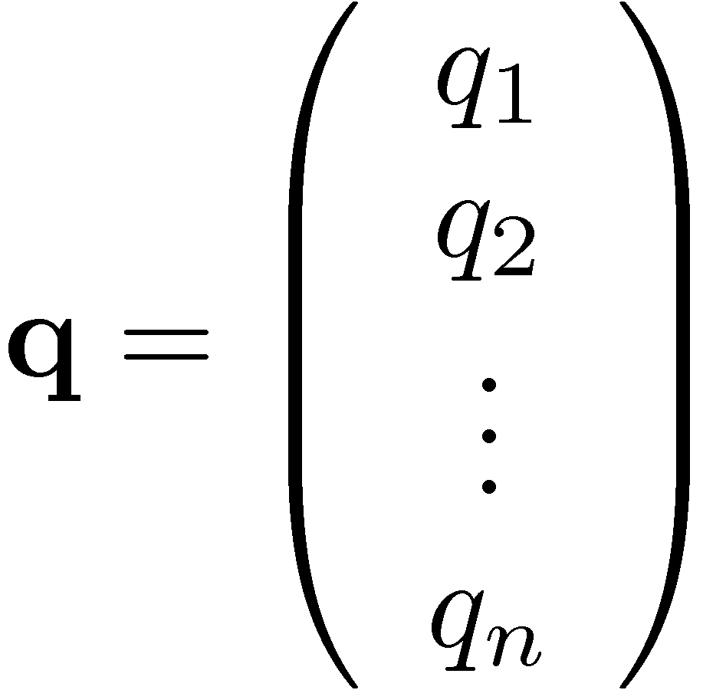
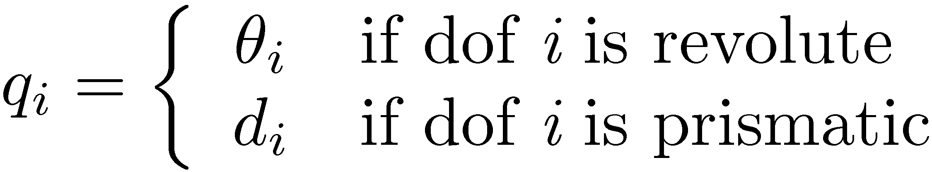

Configuration Space / Degrees of Freedom
A configuration q is a minimal set of parameters required to uniquely specify the position and orientation (pose) of every point on the robot.

Slide 12
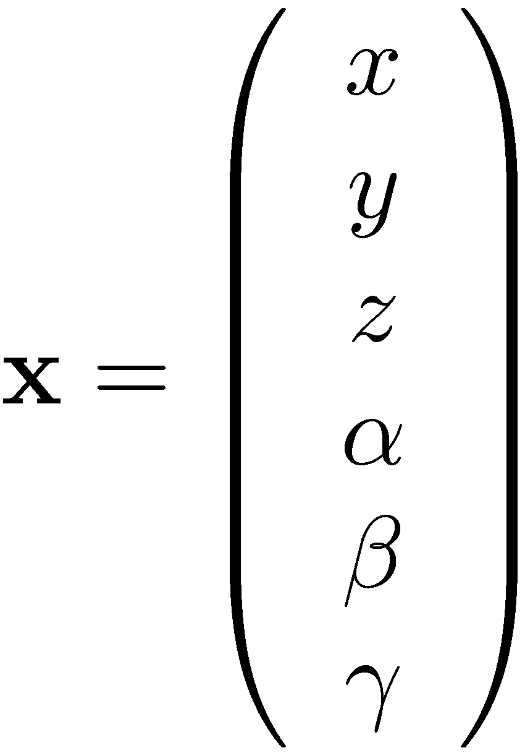

End-Effector Pose in Operational Space
A pose x is a (not necessarily minimal) set of parameters required to uniquely specify the position and orientation (pose) of the robot’s end-effector. The choice of x depends on the task.
Example:
Notes:
Discussion of different task repersentations

Slide 13
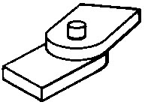
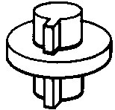
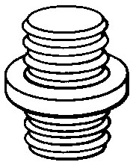
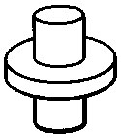
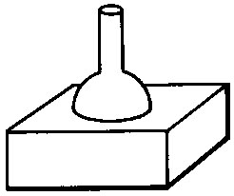
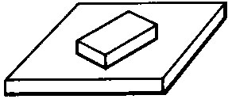
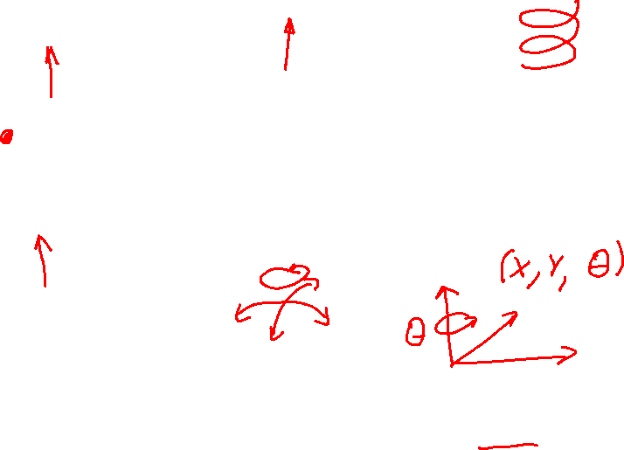
Types of Joints
Revolute: 1 dof
Prismatic: 1 dof
Screw: 1 dof
Cylindrical: 2 dof
Spherical: 3 dof
Planar: 3 dof

Slide 14
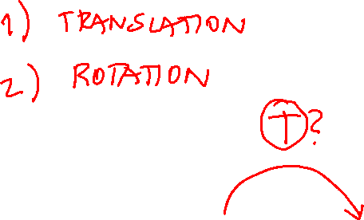
Notes:
Frame assignment: Denavit Hartenberg parameters
https://en.wikipedia.org/wiki/Denavit%E2%80%93Hartenberg_parameters

Slide 15
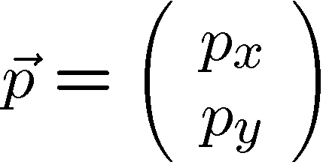
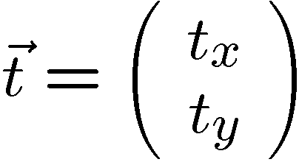
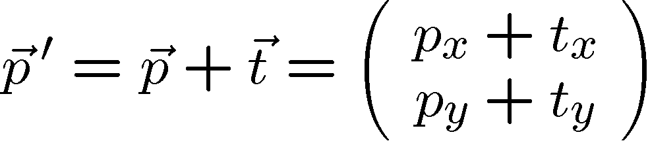


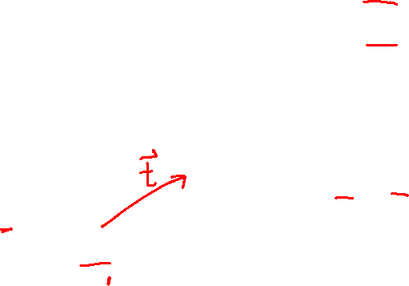
Translation
y
x
Global Reference Coordinate System = World Frame

Slide 16


Rotation
?

Slide 17
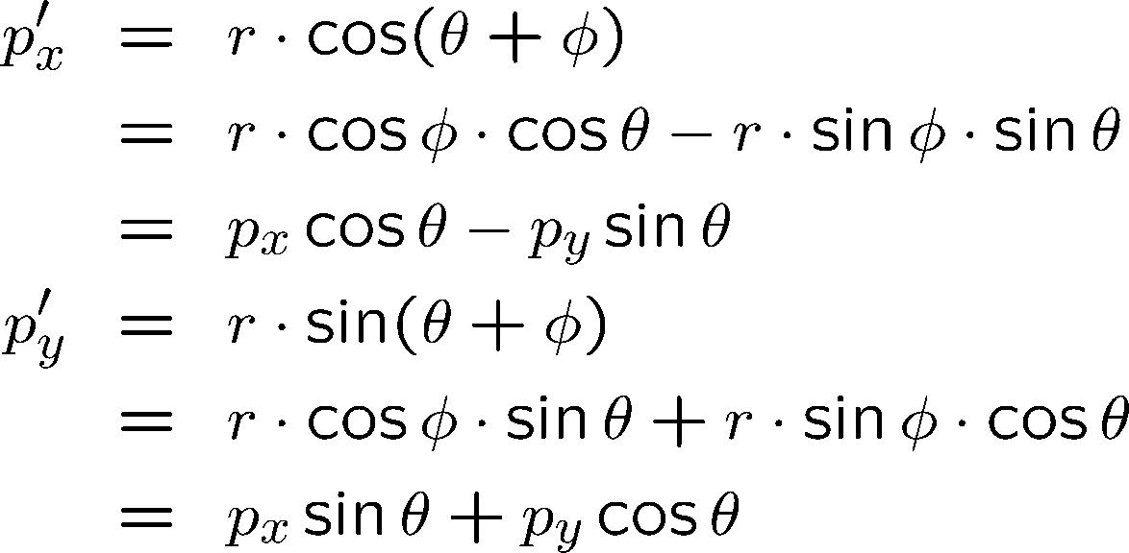
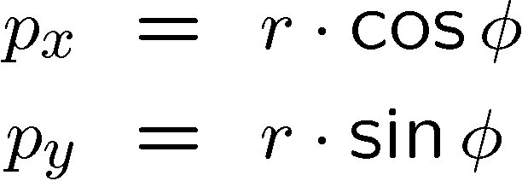
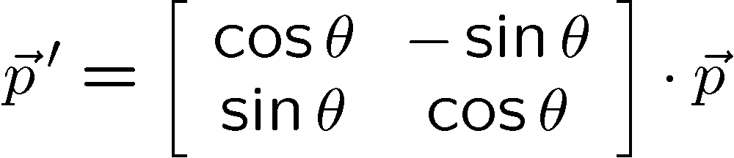




Deriving the Rotation Matrix

Slide 18
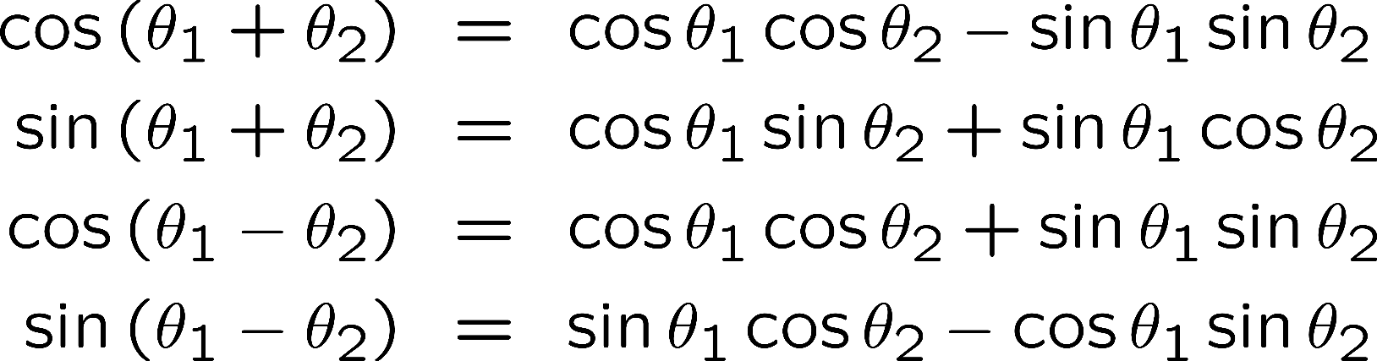

Useful equations for sines and cosines

Slide 19

Properties of Rotation Matrices
Orthogonal
Normal
Determinant = 1
These properties also hold for
rotation matrices in n dimensions!
Notes:
Orthogonality introduces 3 constraints
Normality introduces 3 constrains
9 values (3x3) – 3 – 3 = 3 values needed for representation of rotation

Slide 20


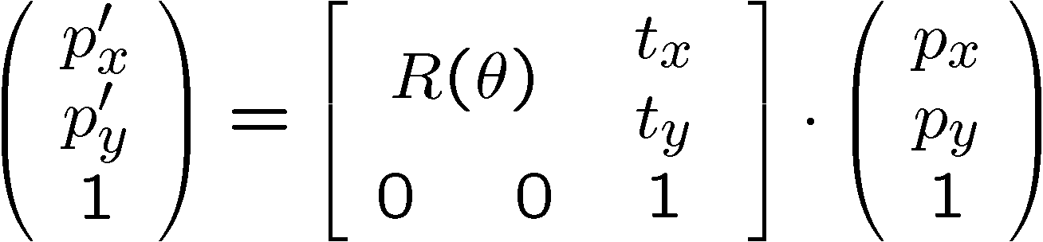
Homogeneous Transformations
Rotation first!

Slide 21
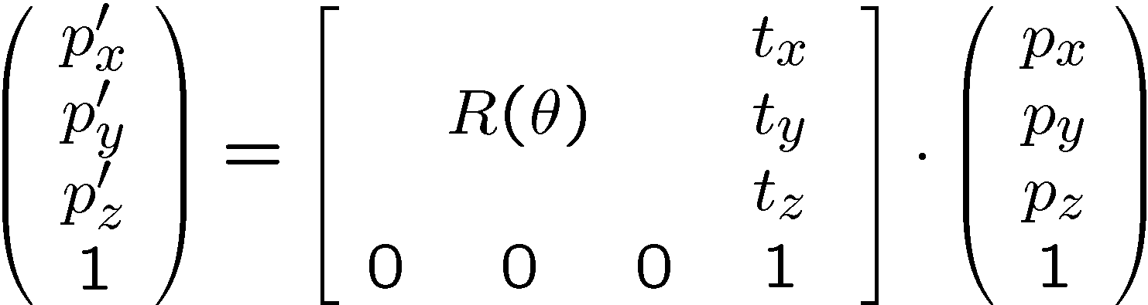
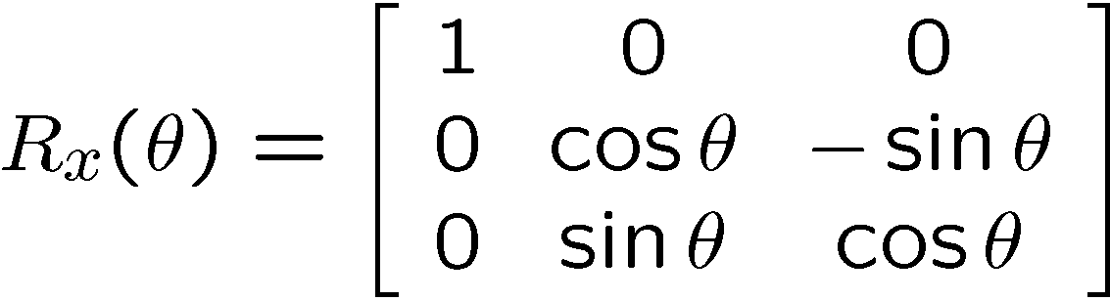
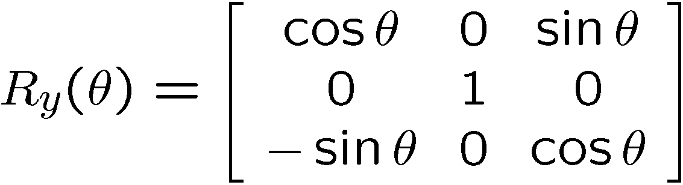
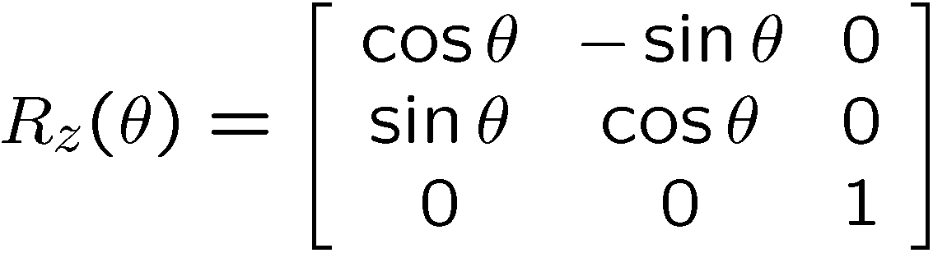
3D Homogeneous Transforms
Notes:
https://en.wikipedia.org/wiki/Homogeneous_coordinates
In mathematics, homogeneous coordinates or projective coordinates, introduced by August Ferdinand Möbius in his 1827 work Der barycentrische Calcul^{[1]},^{[2][3]} are a system of coordinates used in projective geometry, as Cartesian coordinates are used in Euclidean geometry. They have the advantage that the coordinates of points, including points at infinity, can be represented using finite coordinates. Formulas involving homogeneous coordinates are often simpler and more symmetric than their Cartesian counterparts. Homogeneous coordinates have a range of applications, including computer graphics and 3D computer vision, where they allow affine transformations and, in general, projective transformations to be easily represented by a matrix.

Slide 22
Affine Transformations
Rotation
Translation
Scaling
Sheering
and any combination of them
…are affine!
Affine transformations preserve collinearity and ratios of distances.
Notes:
Affine: preserving parallelism of lines, but not lengths and angles
Q: What is the difference between a transformation and a homogeneous transformation?

Slide 23

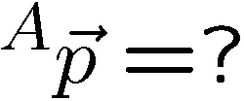

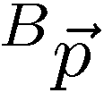


Frames
z
y
x
right-handed coordinate system

Slide 24
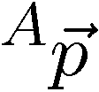
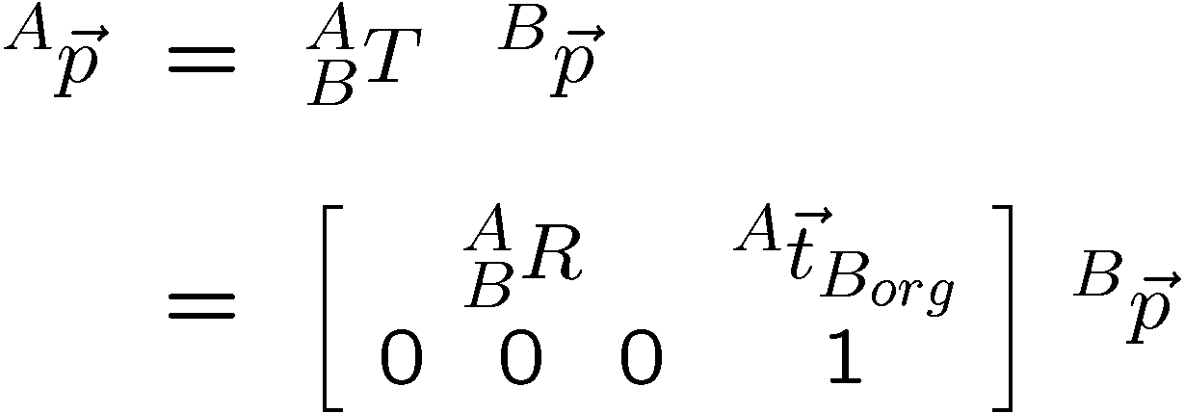
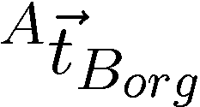
HT to Map between Frames

Slide 25
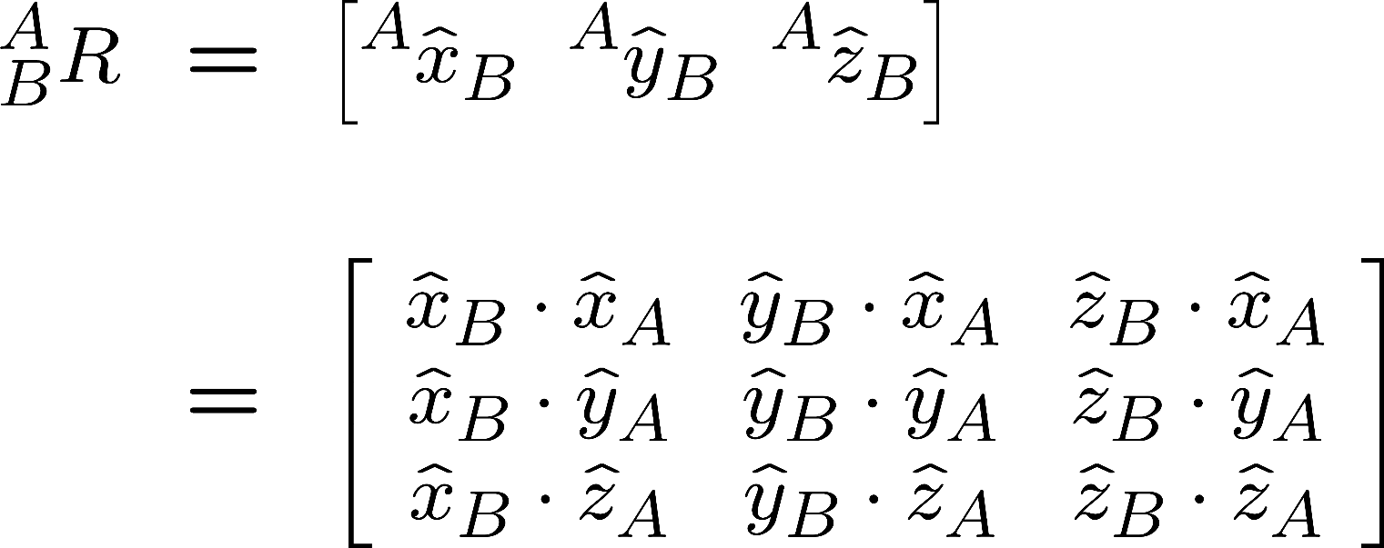
How to compute R?
Direction Cosines
Notes:
Can you tell from this why the transpose of the rotation matrix is equal to its inverse?

Slide 26

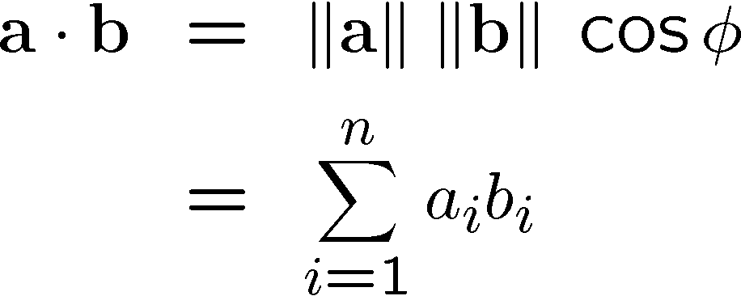


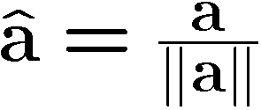
Sidebar: Dot Product (Inner Product)

Slide 27
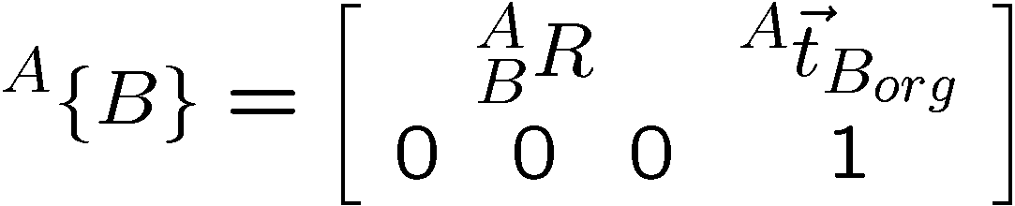
HT as Frame Descriptions

Slide 28
Three Uses for HTs
Frame Description
Mapping between frames
Transform operator
We will be somewhat loose about vectors
and their homogeneous counterparts.

Slide 29
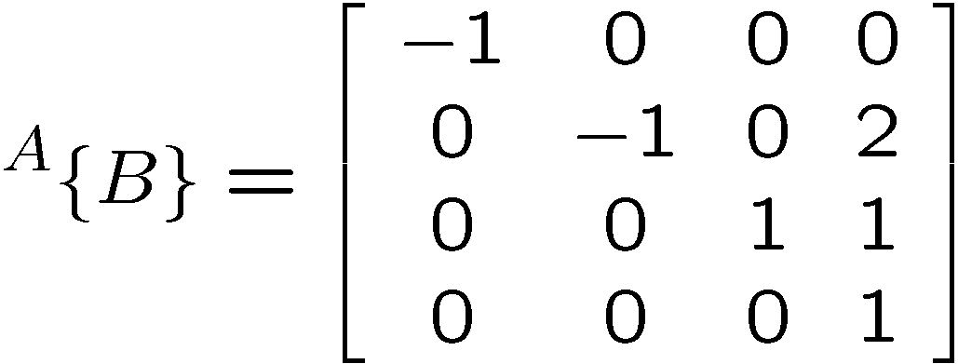
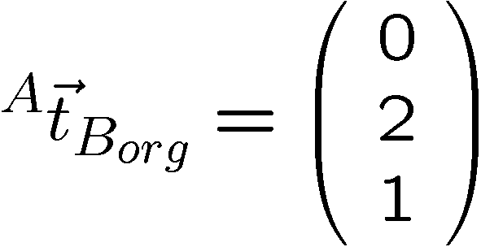
HT: Describing a Frame

Slide 30
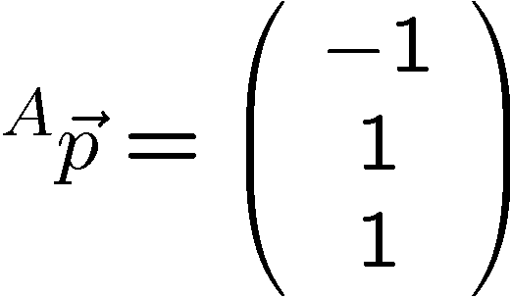
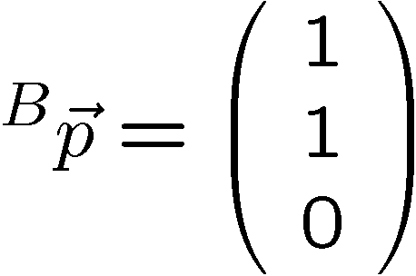
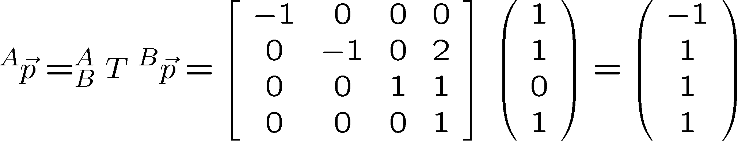
HT: Mapping between Frames

Slide 31
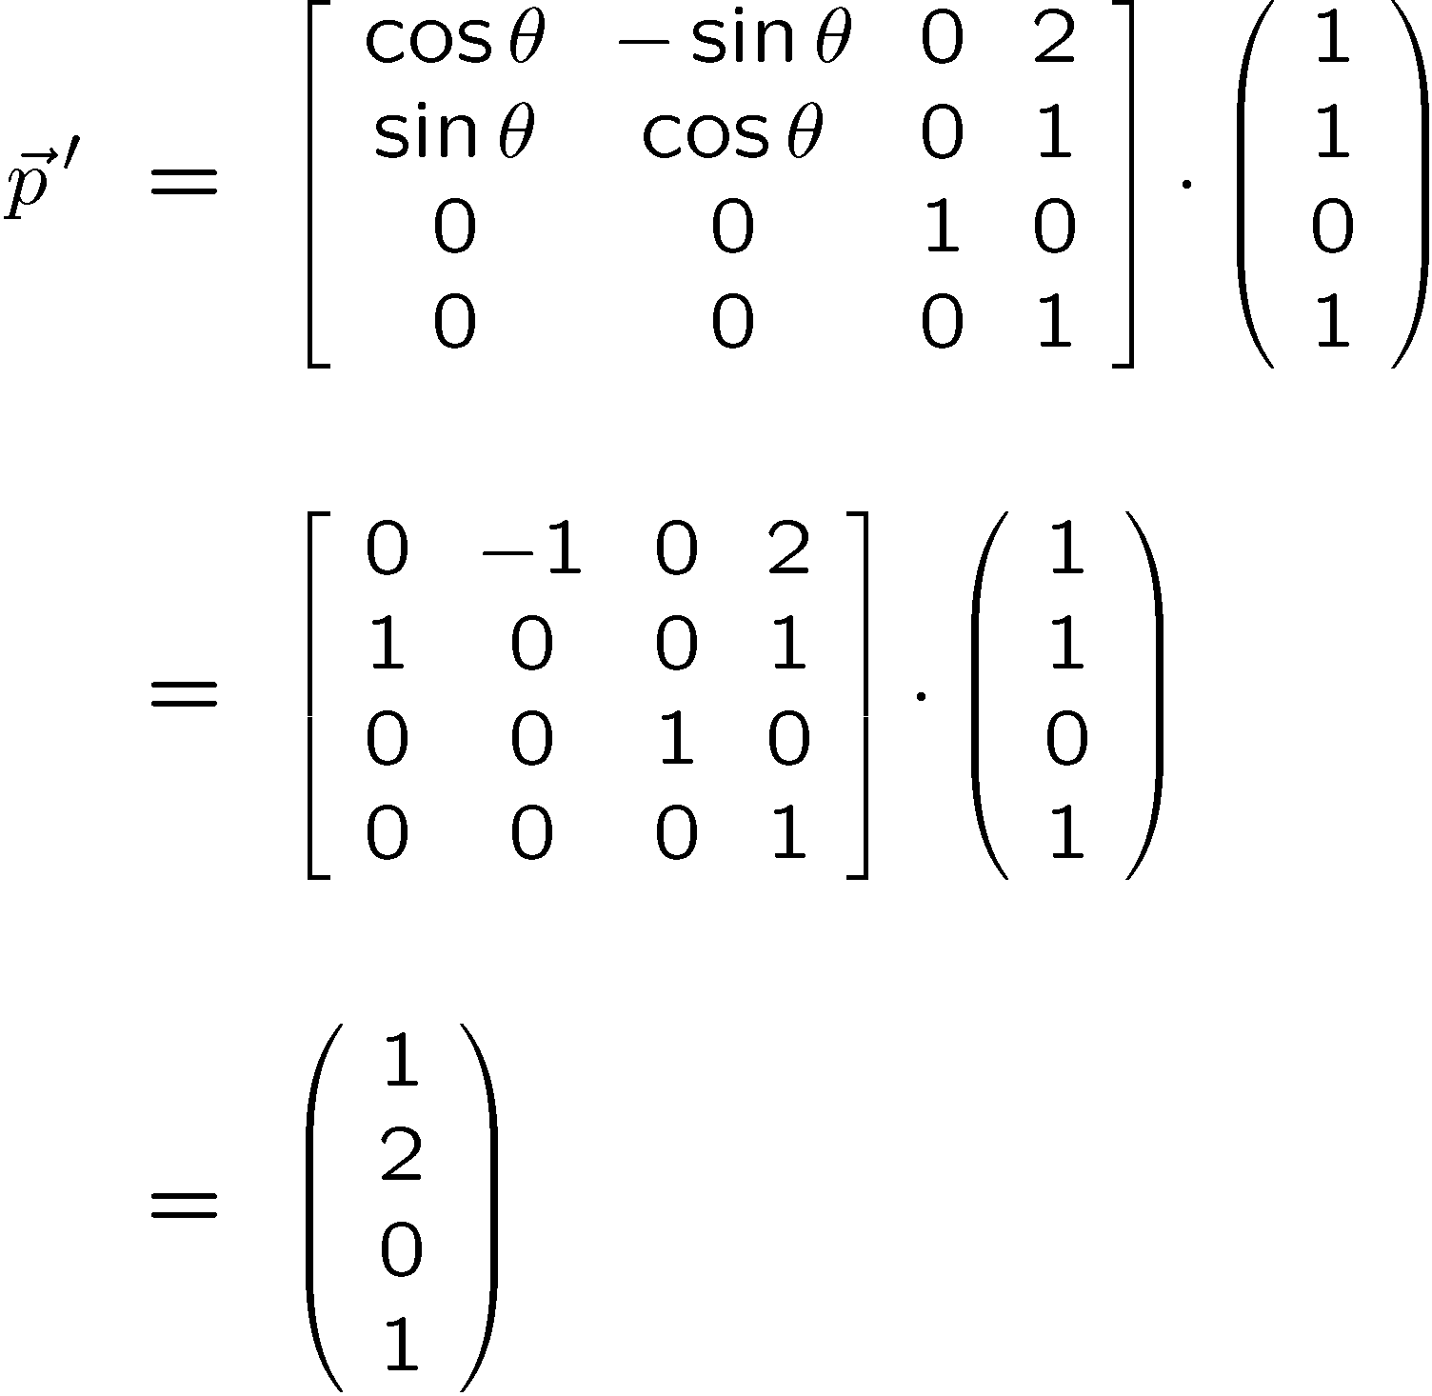
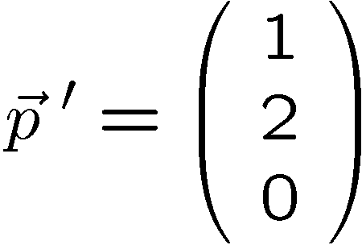
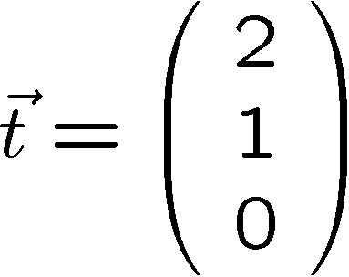
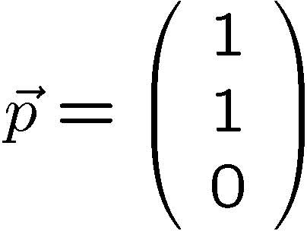
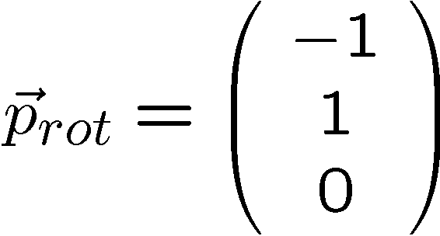
HT: Transforming a point
Rotate by π/2 about z and translate by (2,1,0)
y
x

Slide 32
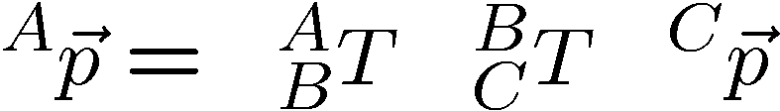

Computing with HTs
Matrix multiplication is NOT commutative! ORDER MATTERS !!!
Notes:
Most efficient to evaluate from right to left.

Slide 33





Inverting !

Slide 34


Slide 35
Review
Affine transformations
Homogeneous transforms
describe frames
map between frames
transform point
Operations with HTs
concatenation
inversion

Slide 36

Notes:
Illustrate what happens when a 2DOF rotational robot arm loses 1 DOF
Background image
https://www.pexels.com/photo/background-black-blackboard-board-159770/

